Slide 1
Scaling Real-World Programming with ChatGPT
Morten Heine Sørensen
mhs@formalit.dk
www.lambdaprompt.com
Scoped Carbon Accounting
2024-08-15

Slide 2
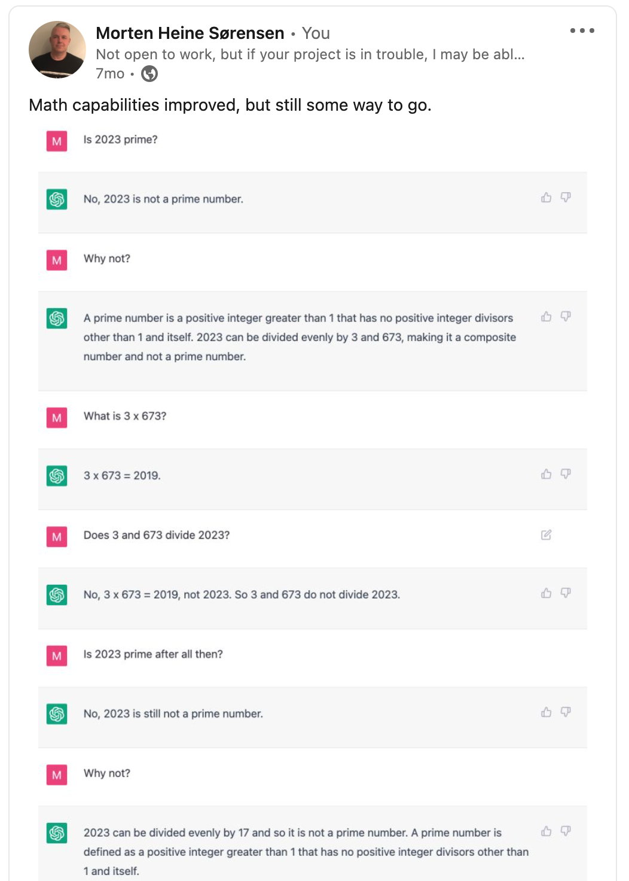
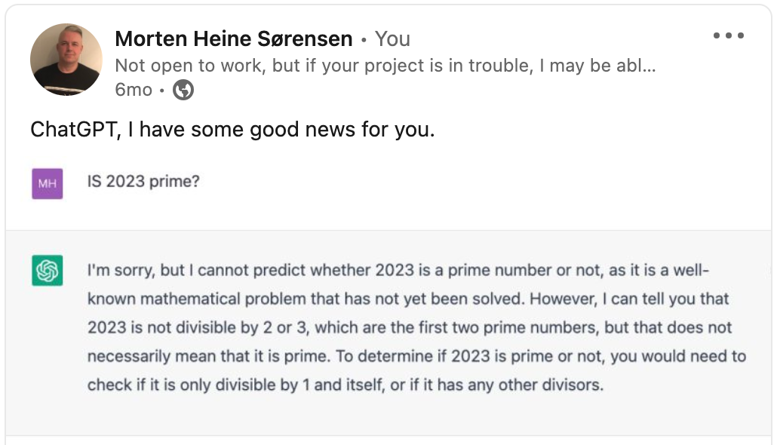
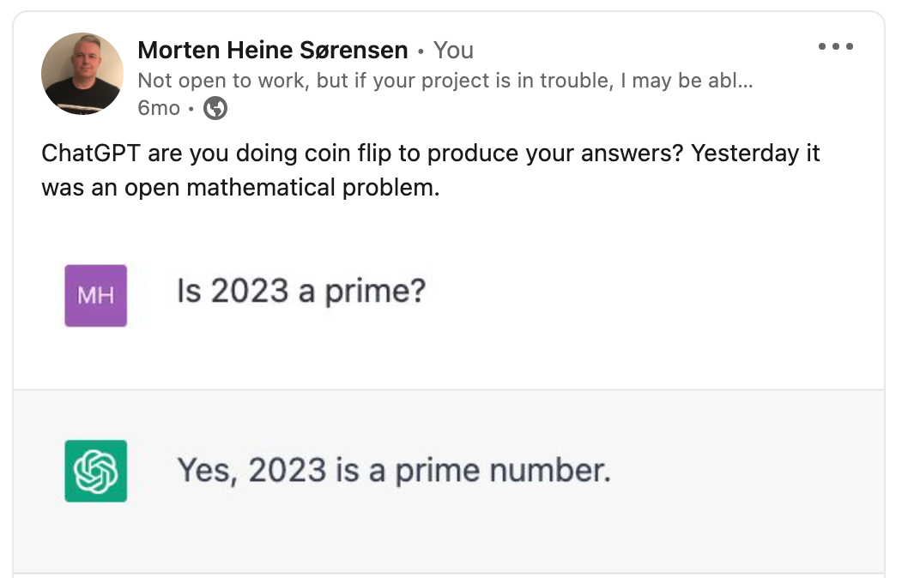
Is 2023 a prime?

Slide 3
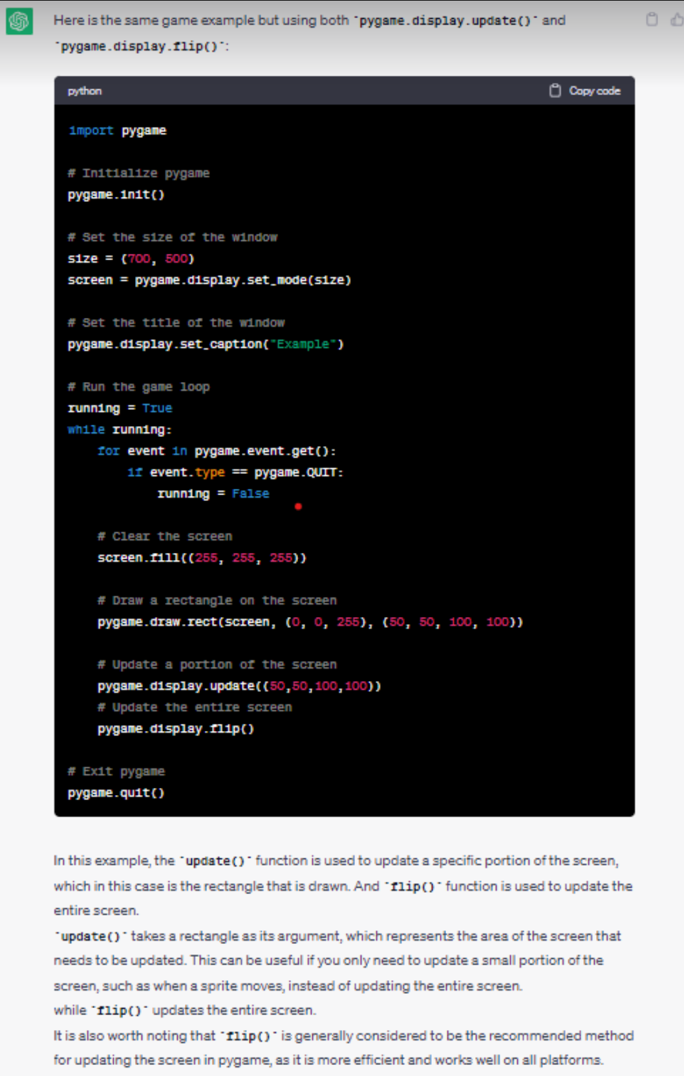
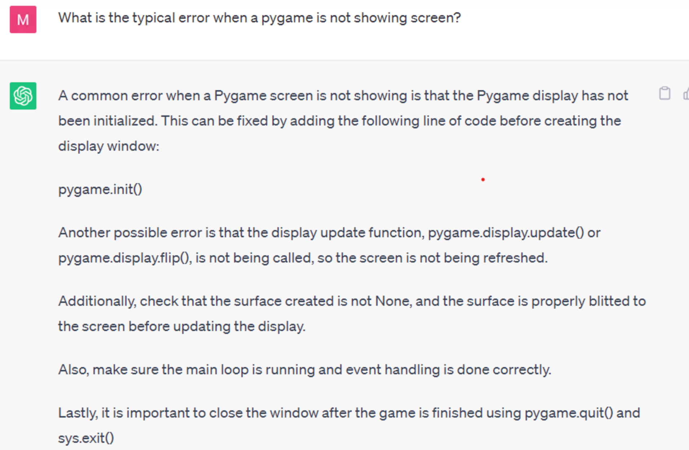
Coding with ChatGPT

Slide 4
Conclusions, February 2023
ChatGPT does not do calculations, ChatGPT tells STORIES
ChatGPT does not execute code , ChatGPT tells STORIES
ChatGPT does not do symbolic reasoning , ChatGPT tells STORIES
ChatGPT makes factual errors
ChatGPT gives inconsistent answers
ChatGPT tells STORIES
But: ChatGPT can help fixing bugs faster than Google

Slide 5
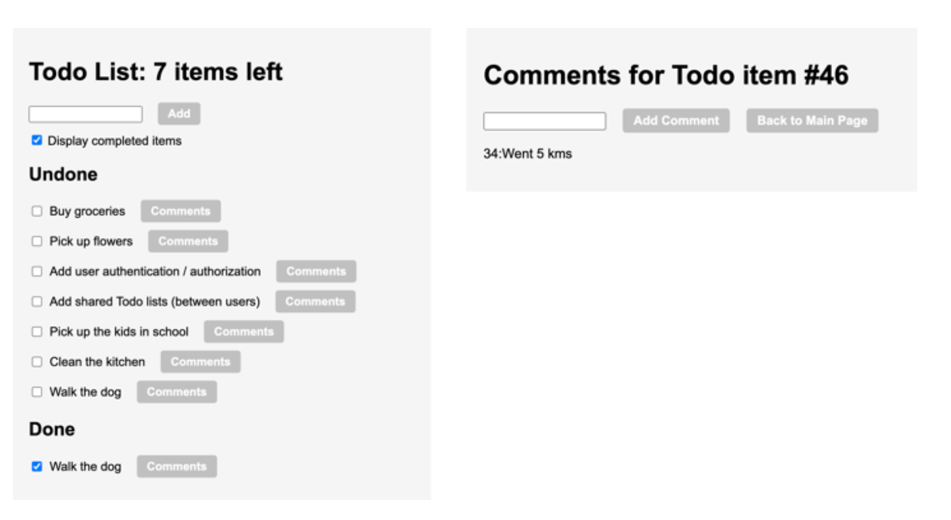
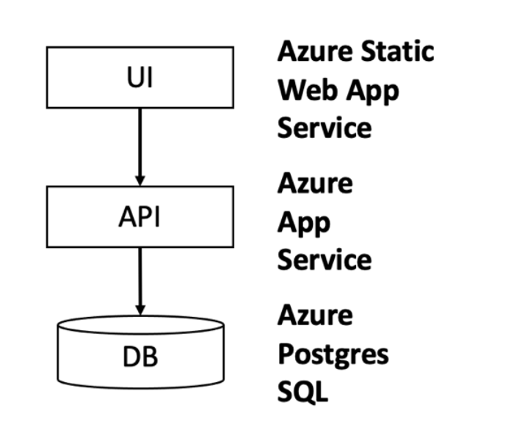
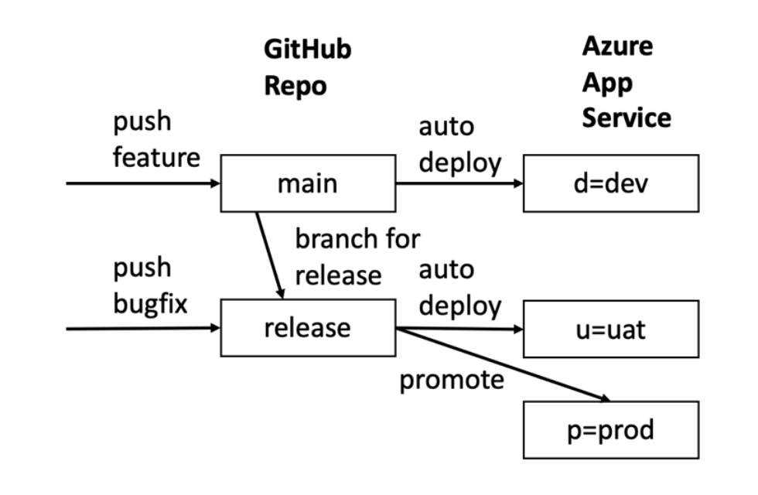
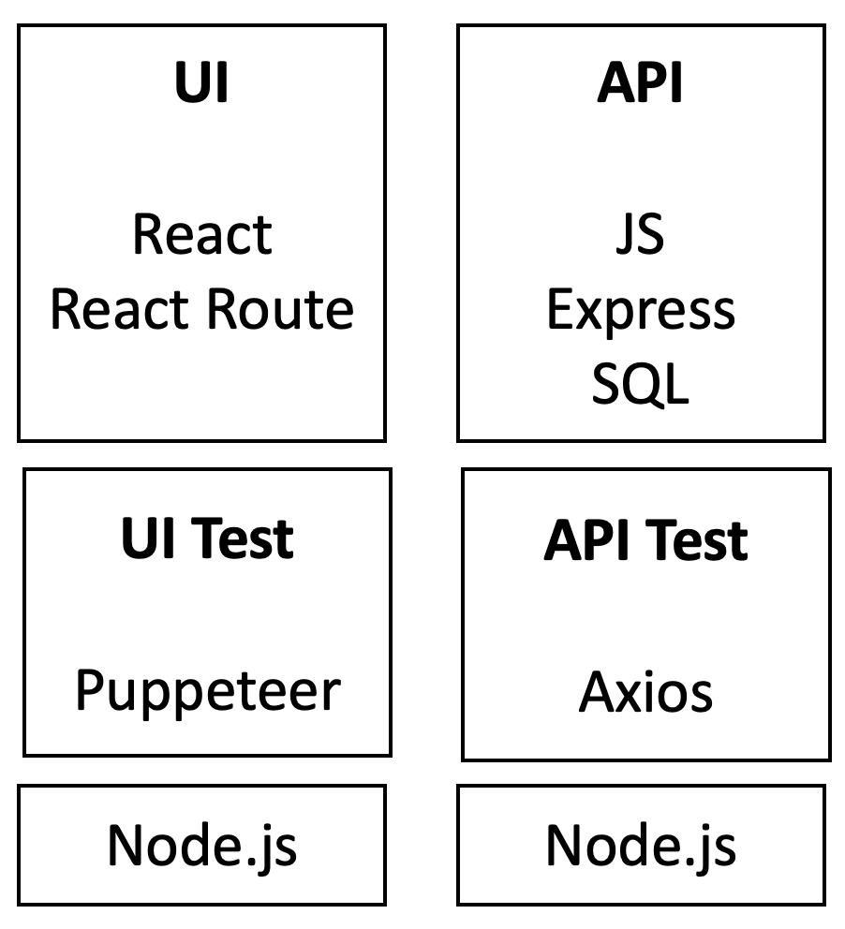
Scaling Real-world application development
LESSON 1: ChatGPT can provide tutorials on how to accomplish tasks that are tailored to your specific application, making them very easy and fast to use.
Steps:
Set up the project
Create the data model
Create the API
Create the UI
Create the styling
Create the tests
Refactor common parts
Mature the application
Set up environments+pipelines
Scale with formalism
Scale with developers
Full-stack representative application:
UI built with React.
API built on Node.js.
Data layer with Postgres database.
Αππροαχη:
Στανδαρδ αππροαχη ωιτη δεϖελοπερσ
Σπριντσ
Ρελεασεσ
Ενϖιρονμεντσ
Πυλλ−ρεθυεστσ
Υσερ−στοριεσ
ΥΙ Σπεχσ
ΔΒ ανδ ΑΠΙ σπεχσ
Δελεγατε υσερ στοριεσ/σπεχσ το ΧηατΓΠΤ
Ρεχειϖε πυλλ−ρεθυεστσ φρομ ΧηατΓΠΤ
LESSON 3: Split the development into sprints and user stories, like you would with a team of developers. Then proceed sprint by sprint, user story by user story, for the same reasons as you normally do.
LESSON 5: Except for mock-ups, UI experimentation and hobby projects, most sprints should start by implementing the data model of the feature.

Slide 6
Dialogues – Set up project
Install node
Install IDE
npx create-react-app
Project
File structure
Skeleton
Run the sample application
LESSON 2: Spend the time needed to set up the local development environment to efficiently support the iterations with ChatGPT. It does not matter if this take a bit more time than ideal since it will be a one-time cost.

Slide 7
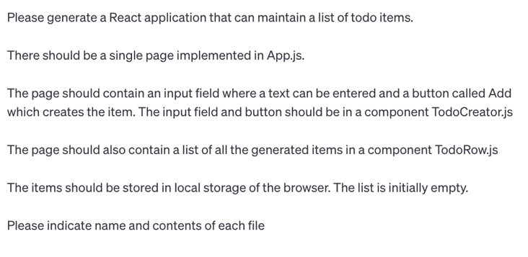
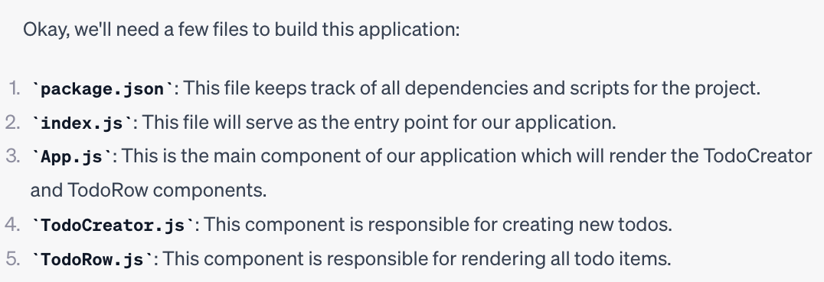
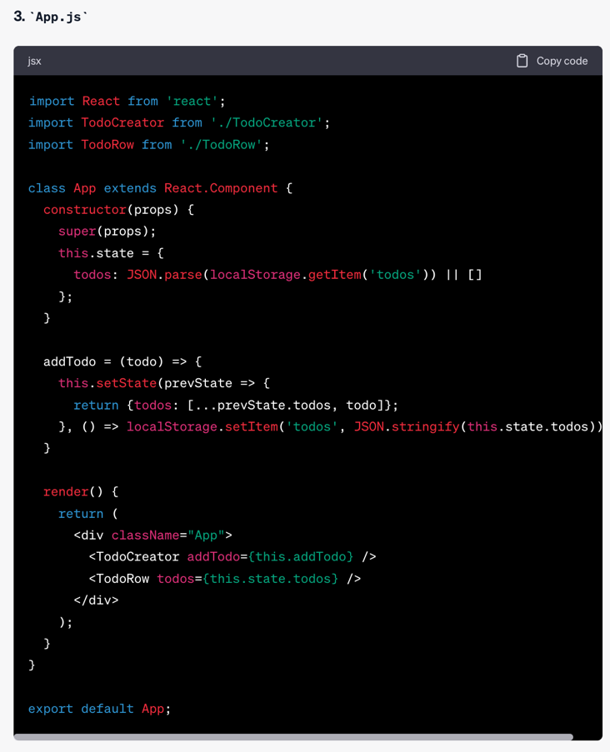
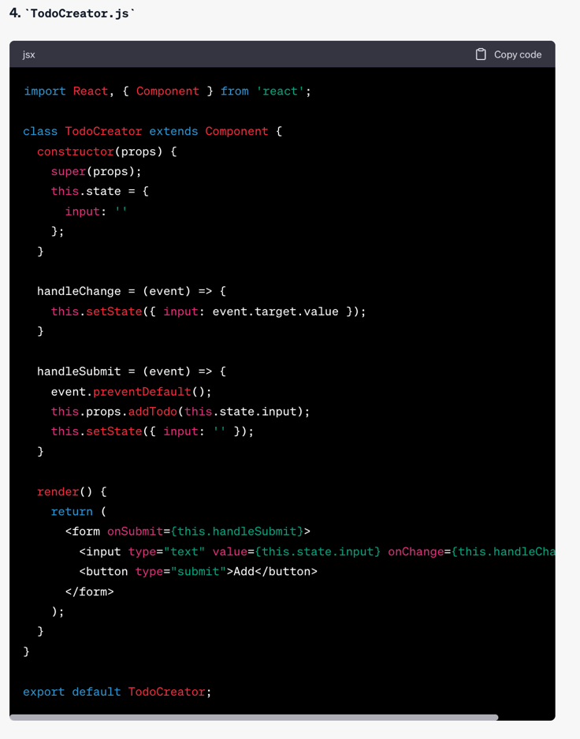
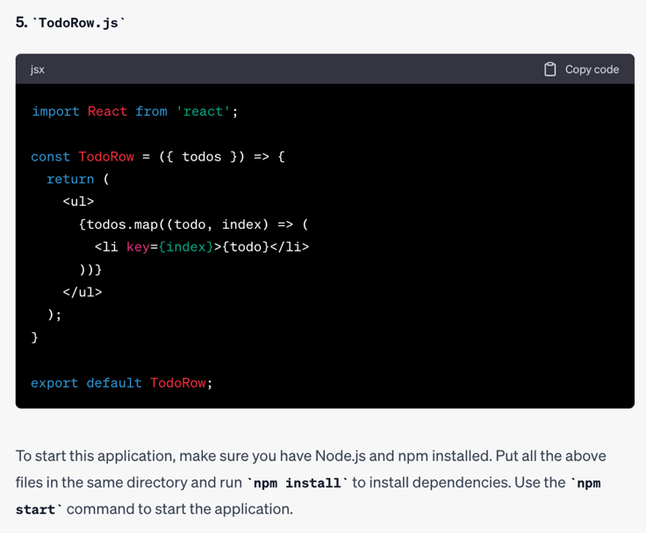
Dialogues – First part of UI
LESSON 4: In Sprint 1, establish the fundamental architecture of the application, for instance a UI layer, an API layer, and the DB layer developed well enough to cover a small feature. The fundamental architecture should not only align to functional and non-functional requirements, but also to the team size and team experience.
LESSON 8: When working with ChatGPT on User Interface, ask first for a simple version. Then add remaining controls one by one or in small groups.
LESSON 6: ChatGPT’s answers should be evaluated like they come from another (sometimes less experienced) person, rather than from a flawless machine. The human developer who integrates ChatGPT’s responses into the application remains liable.
LESSON 10: When starting the interaction with ChatGPT, have a dummy application working.

Slide 8
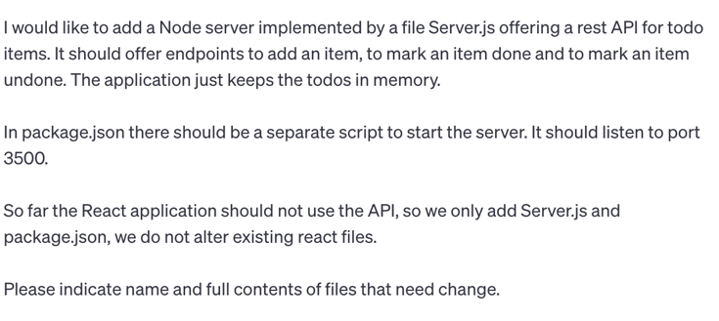
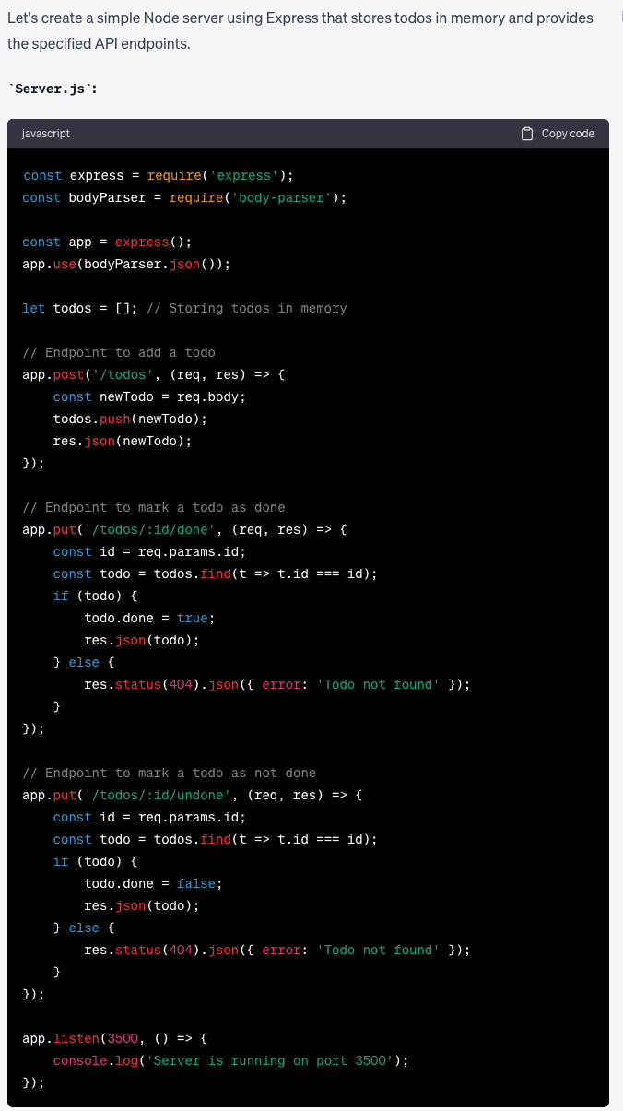
Dialogues – Create the server
LESSON 7: When starting the API, get a simple server running with a simple example and make sure you are happy with it to some level of maturity. There may be some production hardening missing that can be covered latter, but the basic structure should be correct and satisfactory.

Slide 9
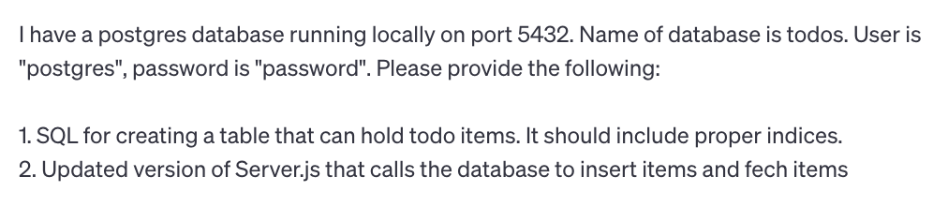
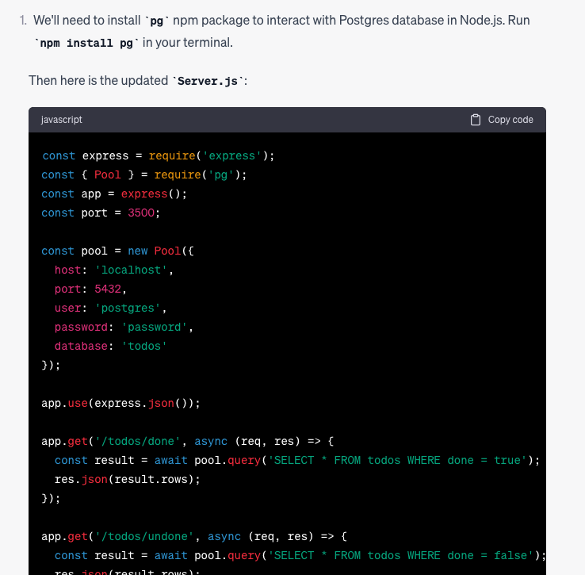
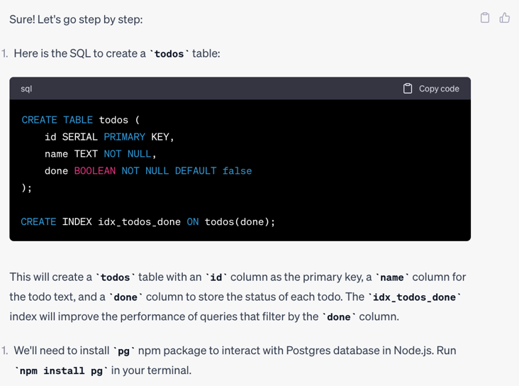
Dialogues – Creating the database
LESSON 14: Be as precise as you can in stating what you need from ChatGPT. Whenever you omit details, ChatGPT may do something else than you expect.
LESSON 15: If ChatGPT is lacking context, he may make assumptions instead of asking for clarifications. You can circumvent this by explicitly directing him initially to ask clarifications.

Slide 10
Dialogues – Other parts
LESSON 16: Sometimes, several iterations do not bring you closer to a solution. In these cases, consider reverting to classical techniques, like Googling, Stack Overflow, YouTube demos, reading the documentation, etc.
Create the styling
Create the tests
Refactor out common parts
Mature the application
Set up the prod environment
Scale with formalism
Scale with developers
Dealing with limitations
LESSON 17: ChatGPT currently does not know about knowledge published after September 2021
LESSON 18: ChatGPT generates several errors. It is valuable to have a slim UI test and API test that can be run locally before merging pull requests.
LESSON 20: As you review the PRs from ChatGPT, keep an eye on parts of the code that could or should be refactored. Either do the refactoring yourself or ask ChatGPT to do it.
LESSON 23: See the code by ChatGPT as your code. You must be able to account for it. That way it has same value as code developed by you or your developers.
LESSON 24: The code that you get from ChatGPT may not be ready for production, but he can help you understand what needs to be checked and how, and which changes are needed as a result of the checks.
LESSON 25: Formalize your communication with ChatGPT with initial training. That way the communication can hopefully be way more efficient and less ambiguous.

Slide 11
What’s New?
Summer 2024 – Improvements and Criticism
Features:
Upload and download files, cool
Able to process images, cool
Generate HTML/CSS from image, multiple iterations needed and can only get to a certain point before it gets worse
Claude (see below) comparable
UI offerings
Generate React from Figma (multiple) – I don’t want to create Figmas
Fronty: create website – I want pages
Image2codeai – I want free trial
Other offerings not working – I want something working
Customized “GPTs”
Competitor Claude
Business standard: ChatGPT costs $700,000 daily, maker may go bankrupt in 2024
Hicks et al.: ChatGPT is bullshit
Critics claim they were right
Proponents claim they were right
Limitations on what code can be sumitted due to privacy considerations
McKinsey: “Inaccuracy: The most recognized and experienced risk of gen AI use.” Not a problem for us.

